Slide 1
Detecting Alzheimer's Disease by Applying Convolutional Neural Network to MRI Scans
Milestone 3
Team Thinkers
Dongho Lee
Christian Yan
Professor Barnabas Bede
CSP 200 Fall 2021
Notes:
Hello class, we are Team Thinkers, and our goal for this semester was to write a computer vision model that could detect Alzheimer’s disease from MRI scans. My name is Dongho Lee, ____________, and we worked with Professor Barnabas Bede. This is our final milestone presentation.

Slide 2
Outline
Our Project
Hardware & Software
Dataset
VGG19
Convolutional Neural Network
ResNet50
Ensemble
Challenges
Conclusion
Future Plans
Notes:
We will first go over how our project could realistically contribute to the medical field, then go over the details of our hardware and software, and the dataset we used, including how many images it had, and how it was augmented.
We will briefly explain the three models that we’ve trained, VGG19, Convolutional Neural Network, and ResNet50. We put these three models together to build what’s called an ensemble, which we will explain later in the presentation.
Then we will go over the challenges we’ve faced, the conclusion we drew, and the future plans we’ve laid out.

Slide 3
Detecting Alzheimer's with MRI Scans
The most reliable way to diagnose dementia is assessing changes in cognitive abilities for several years ^{[1]}.
Currently, by measuring hippocampal volumes, MRI scans correctly identify ^{[2]}:
85% of moderate dementia cases
79% of of mild dementia cases
Notes:
Our project aimed to build a computer vision model that could compete in terms of accuracy with the current method, hippocampal volume measurement. Although the most reliable method of diagnosis is to assess cognitive abilities over a few years, medical professionals can identify it with an 85% accuracy in moderate cases, and 79% in mild cases using MRI scans alone. So, can our machine learning model compete with them? How much hardware and software, and how much time would the model need... to be on the same level as doctors?

Slide 4
Hardware
CPU
Intel i5-10400F CPU @ 2.90GHz (hexa-core)
GPU
NVIDIA GeForce GTX 1660 SUPER
RAM
16GB
Notes:
The hardware we used are as follows: CPU, GPU, and RAM

Slide 5
Software
Basic Environment
Python 3.8.12
Tensorflow 2.3.0
GPU Support
CUDA 11.2
cuDNN 8.1
Notes:
And for the software environment, the following versions were used. We coded in python 3.8.12 and used the Tensorflow library version 2.3.0 to build our machine learning models.
We also installed CUDA and cuDNN to allow Tensorflow to use the GPU. This GPU support meant that we could accelerate the process by a lot, by borrowing the computing power of the GPU. By how much? We will see that in the next slide.

Slide 6
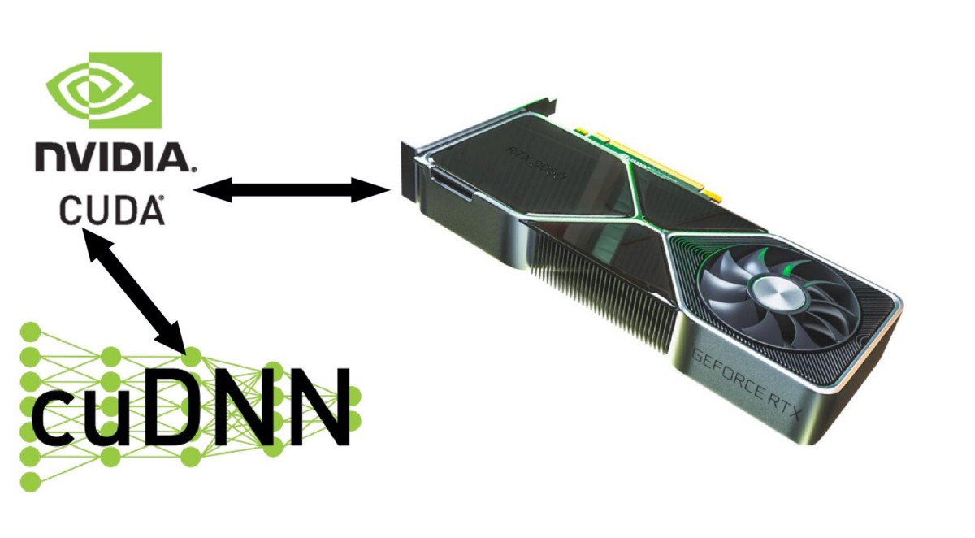
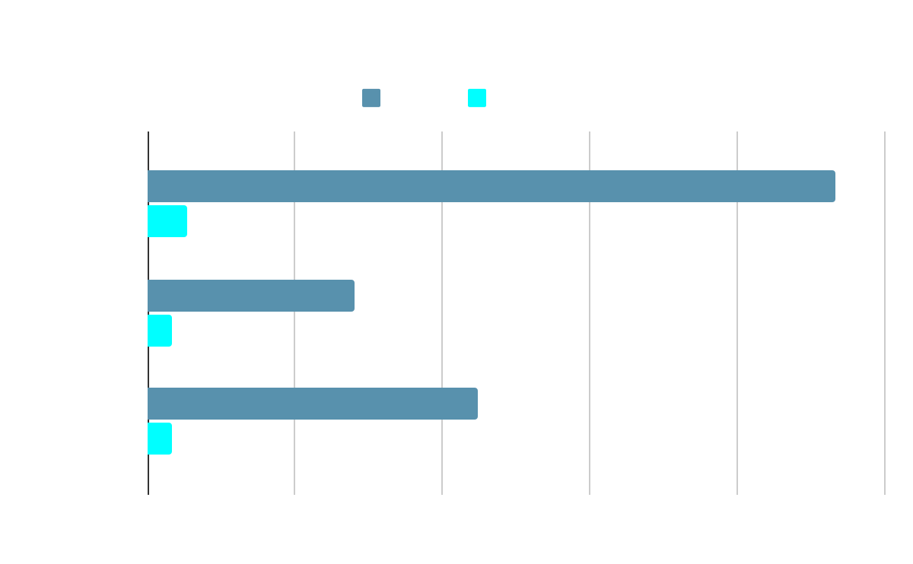
Software
Image source: https://medium.com/analytics-vidhya/installing-cuda-and-cudnn-on-windows-d44b8e9876b5
13 times faster on average
Notes:
By installing the CUDA and cuDNN that allows Tensorflow to tap into the GPU’s computing power, we could make the training process 13 times faster as clearly shown on the chart here. So we didn’t have to worry about the speed anymore, but now we wanted to train using more data.

Slide 7
Dataset
Kaggle
Training - 5121 images ─ horizontal flipping (+5121)
→ augmented dataset (10242 images)
Testing - 1279 images
Notes:
To our surprise, MRI images of dementia patients were very difficult to find. There were 3 results on Kaggle but all of them were the same dataset. And we didn’t gain access to ADNI until recently and we are not authorized to see most of the search results on it. So we stuck with the 5121 images, but doubled them by flipping the images horizontally (since the brain is largely symmetrical)

Slide 8
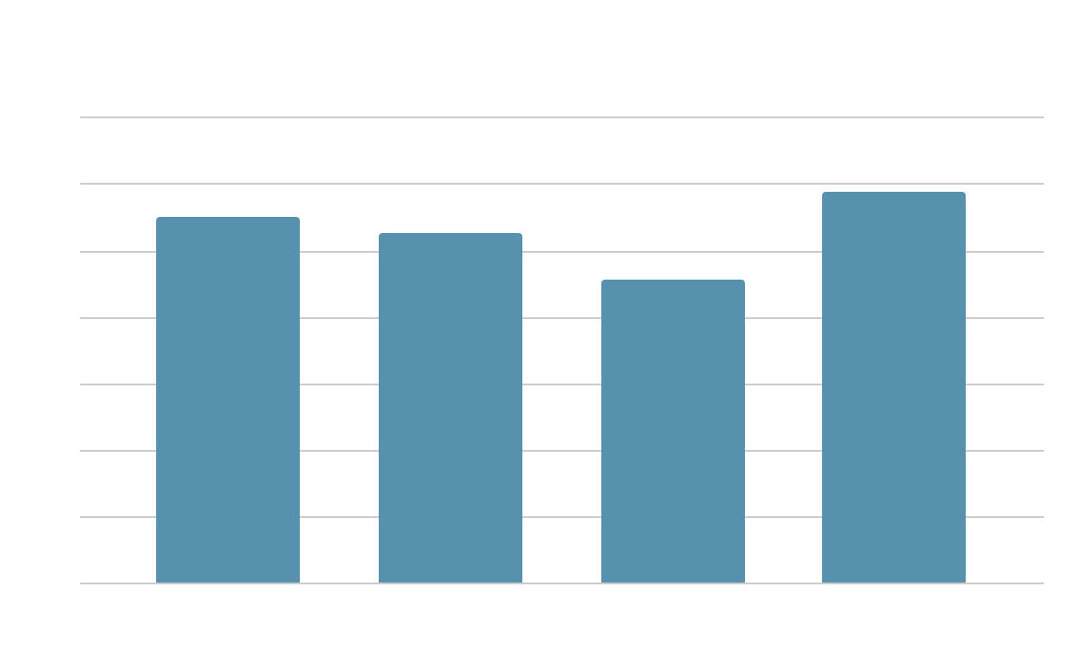
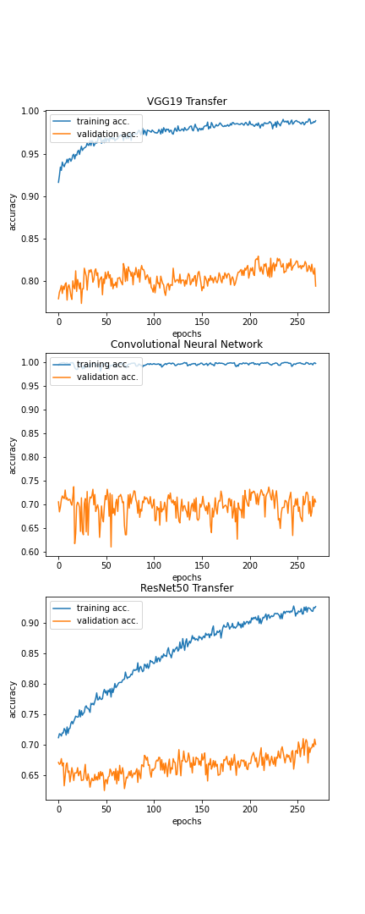
VGG19
Notes:
Now, we’ve trained 3 models in total: Transfer learning with VGG19, Convolutional Neural Network, and transfer learning with ResNet50. And these were trained for 300 epochs. Transfer learning using VGG19 was the best-performing model overall, almost reaching an 80% accuracy, although it was strange that it was better at identifying lower degrees of dementia.

Slide 9
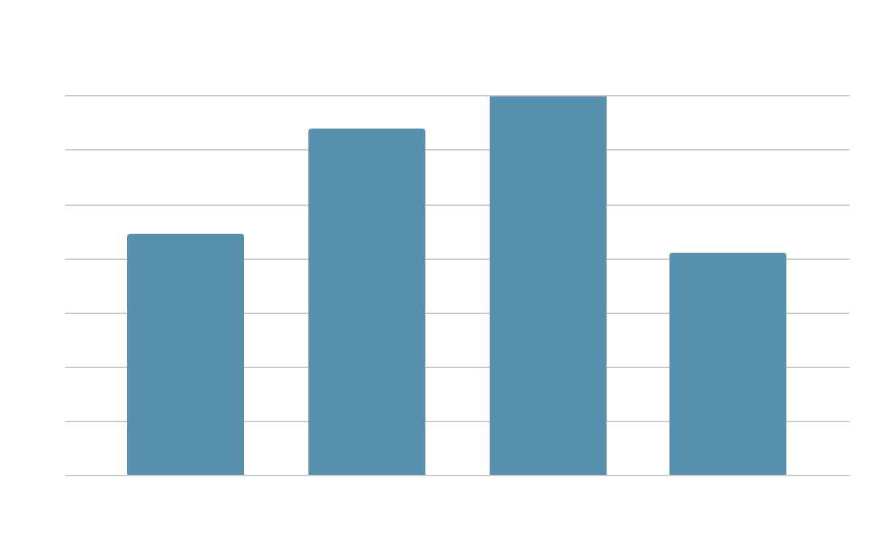
Convolutional Neural Network
Notes:
Our own Convolutional Neural Network had an accuracy that was just over 70%. For this model, the accuracies for different severity levels were close to what we had expected: it was better at identifying more severe cases.

Slide 10
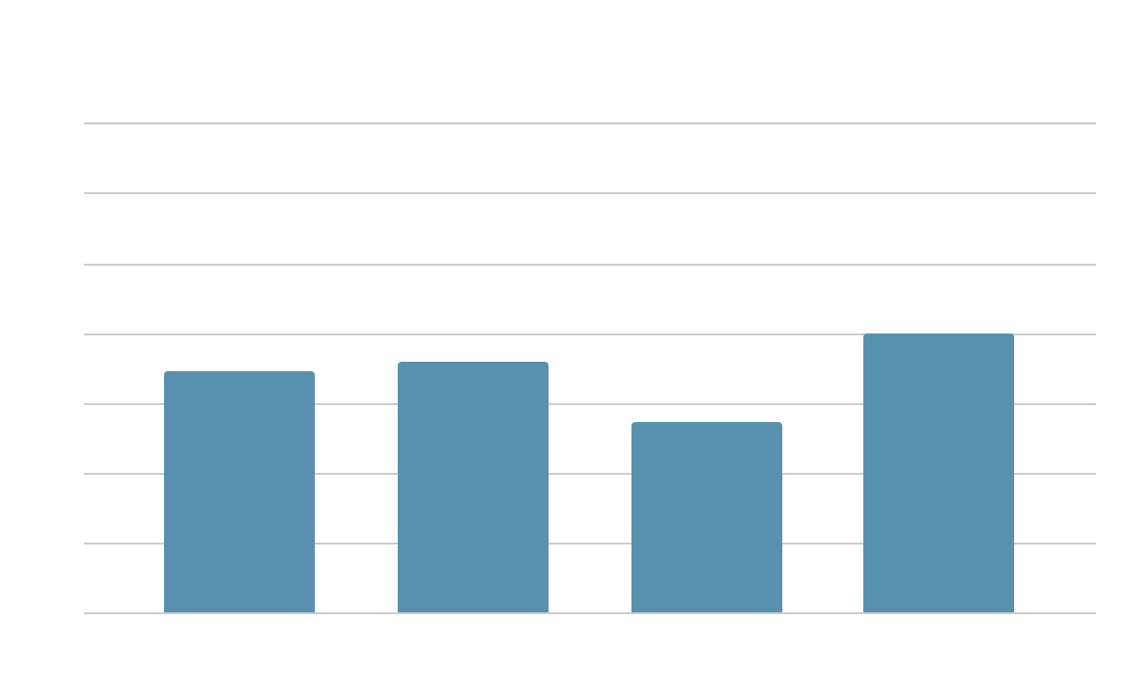
ResNet50
Notes:
And lastly, transfer learning using ResNet50 was the slowest learner, and also the worst performing one. Although the training accuracy was showing a steady increase as shown in blue here, the validation accuracy was not following that trend. And like the VGG19 model, we saw a decrease in accuracy when it came to more severe cases of dementia. But overall, it still reached a 70% accuracy by the end of the training.
In conclusion, all three models were within the 70-80% accuracy range, which is pretty reasonable compared to hippocampal volume measurement that we saw earlier.

Slide 11
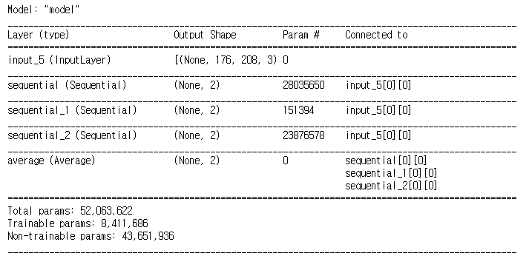
Ensemble
What is an ensemble?
A set of independent models that have been trained separately
Voting
The easiest implementation is as follows
[0.233, 0.767]
[0.440, 0.560] [0.435, 0.565] Demented
[0.632, 0.368]
Average()
Classification
Notes:
So now that we have our 3 models that perform more or less the same, we can do what’s called an ensemble, a set of independent models that vote to determine the correct output. Due to time constraints, we used the Average() layer in keras to build a model that looks like this. Note that this is not a true voting system since if one model is extremely confident that some brain has dementia and other to models disagree, the con

Slide 12
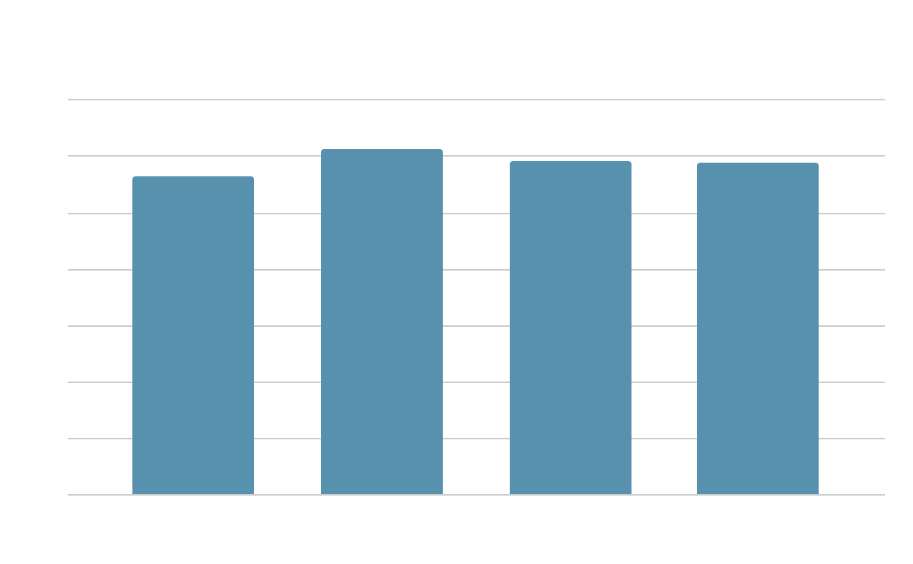
Ensemble
VGG19 + CNN + ResNet50
Reached 80% accuracy!
Notes:
The accuracy levels for different levels of severity look more balanced and we were able to achieve 79% accuracy, which is similar to the accuracy of the hippocampal volume measurement method.

Slide 13
Challenges
Lack of time to research preprocessing methods, especially
keras.applications.vgg19.preprocess_input()
keras.applications.resnet50.preprocess_input()
The misguided accuracy goal (95+%) due to the assumption that AUC (area under curve) and accuracy were similar metrics
Version control wasn’t thoroughly thought out
The closest we had was branching files and setting naming conventions

Slide 14
Conclusion
Binary ensemble model is as accurate as hippocampal volume measurement
Individually, VGG19 was the best-, and ResNet50 was the worst-performing model
Image augmentation marginally increases the accuracies

Slide 15
Future Plans
Research the preprocessing functions mentioned earlier
Replace ResNet50 with ResNet101
Implement a true voting system for the ensemble
Enhance the prediction by measuring hippocampal volumes via DBSCAN

Slide 16
References
[1] Lombardi G, Crescioli G, Cavedo E, Lucenteforte E, Casazza G, Bellatorre A, Lista C, Costantino G, Frisoni G, Virgili G, Filippini G., “Structural magnetic resonance imaging for the early diagnosis of dementia due to Alzheimer's disease in people with mild cognitive impairment,” Cochrane Database of Systematic Reviews, issue 3, no. CD009628, 2020.
[2] T. S. Ramachandran, S. B. Zachariah, V. K. Agrawal, S. Parikh, and A. Swarnkar, “How accurate is MRI in the diagnosis of alzheimer disease?,” Latest Medical News, Clinical Trials, Guidelines - Today on Medscape, 12-Nov-2019. [Online]. Available: https://www.medscape.com/answers/336281-188276/how-accurate-is-mri-in-the-diagnosis-of-alzheimer-disease. [Accessed: 30-Nov-2021].

Slide 17
Thank you!
Questions?

